Slide 1
NYSE MARKET DATA AND RISK ANALYSIS
Presented By:
Anuj Tomar
Jasleen Kour
Rohit Soni

Slide 2

INTRODUCTION
NYSE is an acronoym for New York Stock Exchange and dates back to May 17 1792 which is the one of the largest stock exchanges and one of the busiest and most important stock exchange with around 1.46 billion shares a day and with over 2800 companies which range from blue chip to high -growth companies.
It exists as a physical market as well as automated exchanges with trades.

Slide 3
Scope of Project
The goal of the project is to analyze the stock performance of the selected 25 stocks over the five year period from Oct 2017 to Sep 2022
The stock performances have been evaluated by using the key parameters like Closing prices , Adjusted Closing prices and Volume traded per stock.
Project only covers the equity stocks and does not consider bond market, ETF and index funds.
Targeting the top sectors of the NYSE based on the market cap distribution as of dated Jan 7, 2022 which are namely IT, Healthcare, Financials, Consumer staples and Energy.
As per the highest market cap of the individual companies enlisting five per each sector to balance the portfolio analysis

Slide 4
Data Description
The data was collected in the form of the 25 CSV files downloaded from the yahoo finance and 1 Excel file across selected five categories of Finance, Healthcare, Consumer staples, Information Technology and Energy.
The Final data file contains 1258 rows and 157 columns with major columns as Open, Close, High, Low , Adjusted Close and Volume.
SECTOR | IT | Healthcare | Financial | Consumer Staples | Energy
1 | TSM | JNJ | JPM | UL | XOM
2 | BABA | UNH | BRK | WMT | SHEL
3 | ORCL | PFE | V | PG | TTE
4 | SAP | LLY | MA | KO | COP
5 | CRM | ABT | BAC | PM | CVX

Slide 5
PROBLEM STATEMENT
Analyzing the stock performances by visualizing the price and traded volume variation.
Calculating the Individual Daily and Annualized returns for each stock
Determining Risk involved with each stock
Creating a Investment portfolio based on risk and Returns along with calculating the cumulative portfolio returns.

Slide 6
Data Preparation and Cleaning
Individual stock data files along with market index S&P 500 Data file were merged into one single data frame for conducting analysis.
The merged data frame was checked for any null values or any duplicate values.
Most of the data was clean and for our analysis we have majorly focused on Closing prices and Volume columns.

Slide 7
DATA ANALYSIS
Time Series Analysis

Slide 8
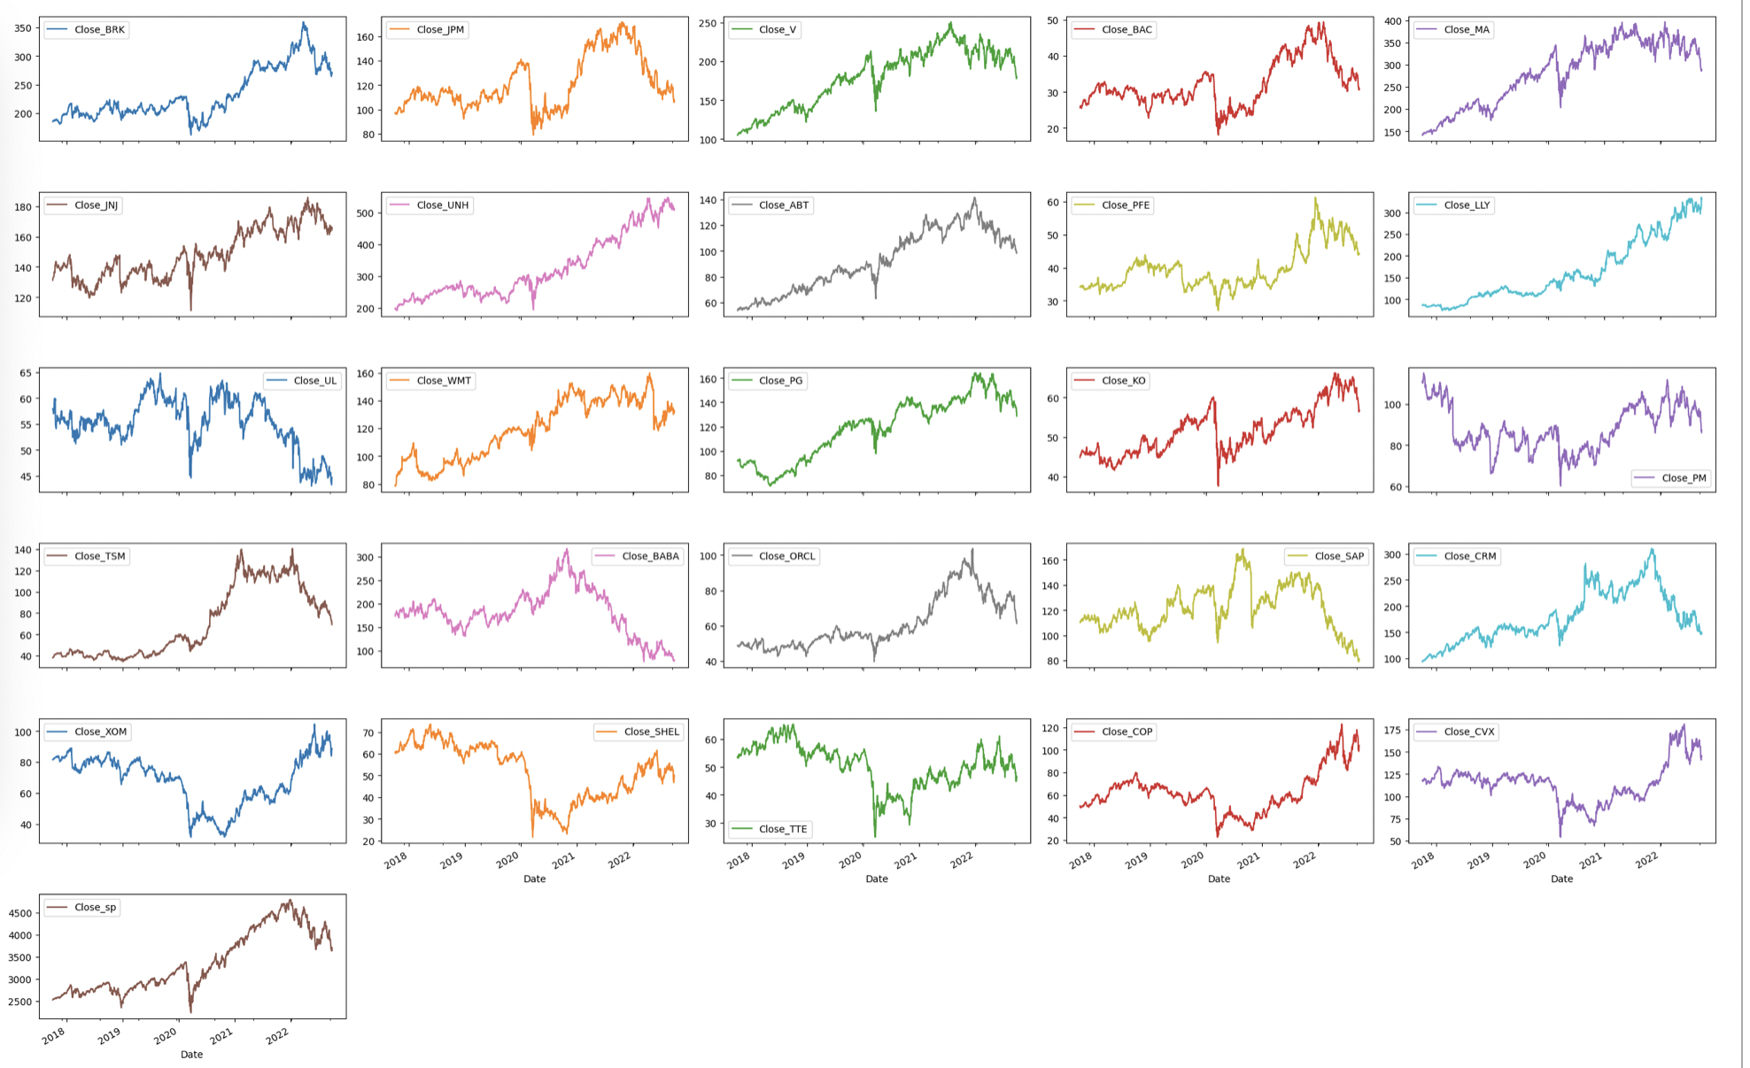
Price Analysis
Line graphs for Closing prices of all the stocks
For an overview of price variation across individual stocks we selected the closing price column and plotted a times series graph.
The time series graph filters out the stocks which show an upward trend in their prices over the period of time indicating them a good fit for investment.
Findings:
All the stocks have have seen upward trend in prices except SAP, CRM,BABA and UL .

Slide 9
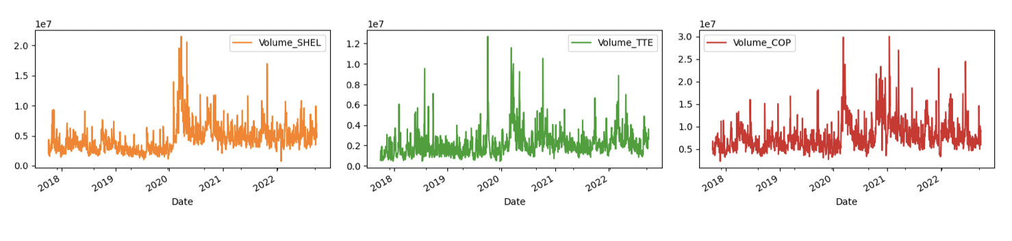
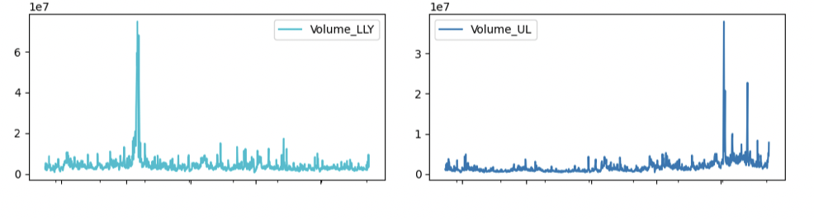
Volume Analysis
Stocks with Increased volume
The line graphs of volume for individual stocks distinguishes the stocks which have seen an increase in their volume traded over the period of five years.
The higher volume traded with an increase in prices signifies an increased investor interest.
Findings:
Except Health stocks which have largely remained constant in volume , all the stocks have shown an increase in volume.
Stocks with stable/no Volume

Slide 10
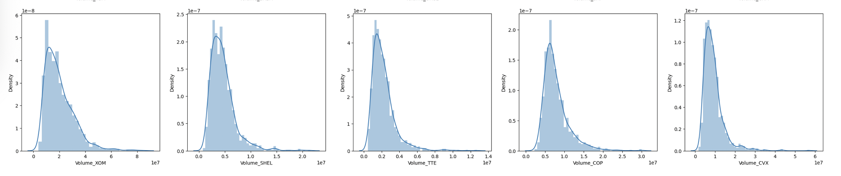
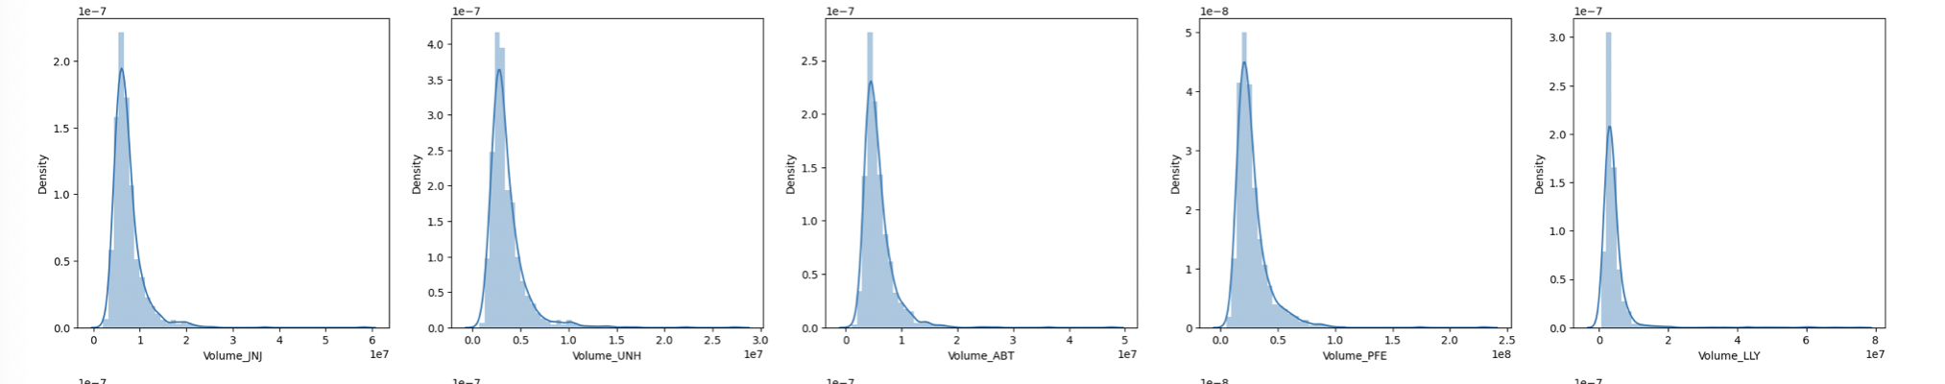
Volume Analysis- Histogram Plot
Energy Stocks Volume Distribution
The volume traded focusses on the amount of volume or quantity of stocks traded in the market.
For this we have visualized the volume for individual stocks using histogram plots and line graphs.
In Histogram plots the stocks with higher standard deviation are more volatile and will cover more area.
Findings:
Following stocks were more volatile;
In Financial category-BAC,MA and JPM
In Consumer staples-KO,PG and WMT
In Tech Stocks- TSM and ORCL
In energy stocks- XOM ,SHEL and TTE
Health Stocks Volume Distribution

Slide 11
Data Analysis
Comparison Analysis

Slide 12
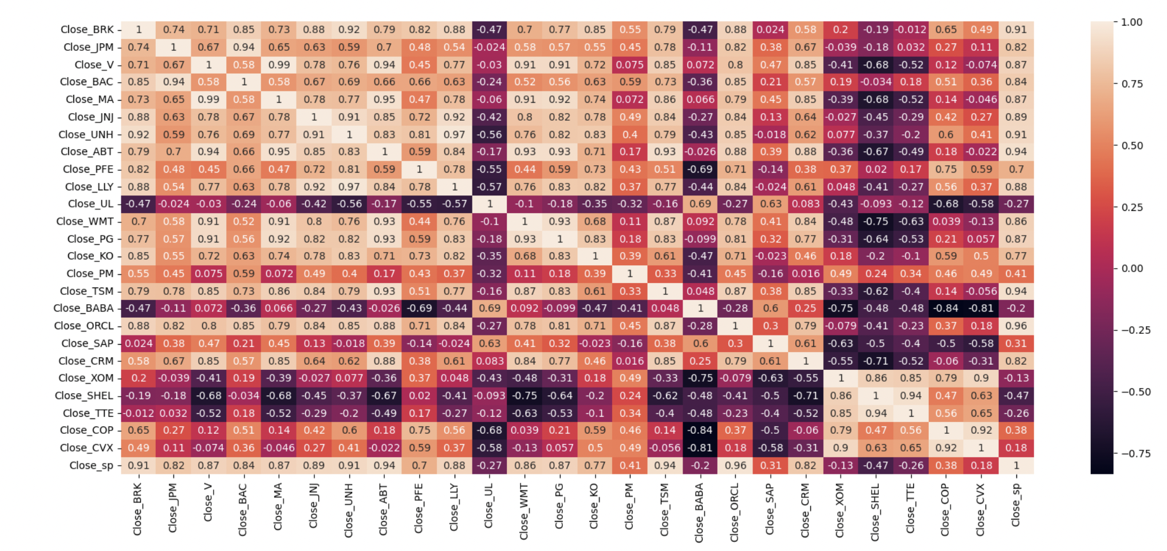
Price Correlation matrix- The prices for the individual stocks were then compared to the market index S&P 500.
Findings:
Highly positive correlation: ORCL,TSM,ABT,UNH and BRK having 0.9 and above –indicating high similarity with Closing price movement of Market index.
Negative Correlation: UL,BABA,XOM,SHEL and TTE – these are stocks to be filtered out from the further analysis as they are prone to risk and loss.

Slide 13
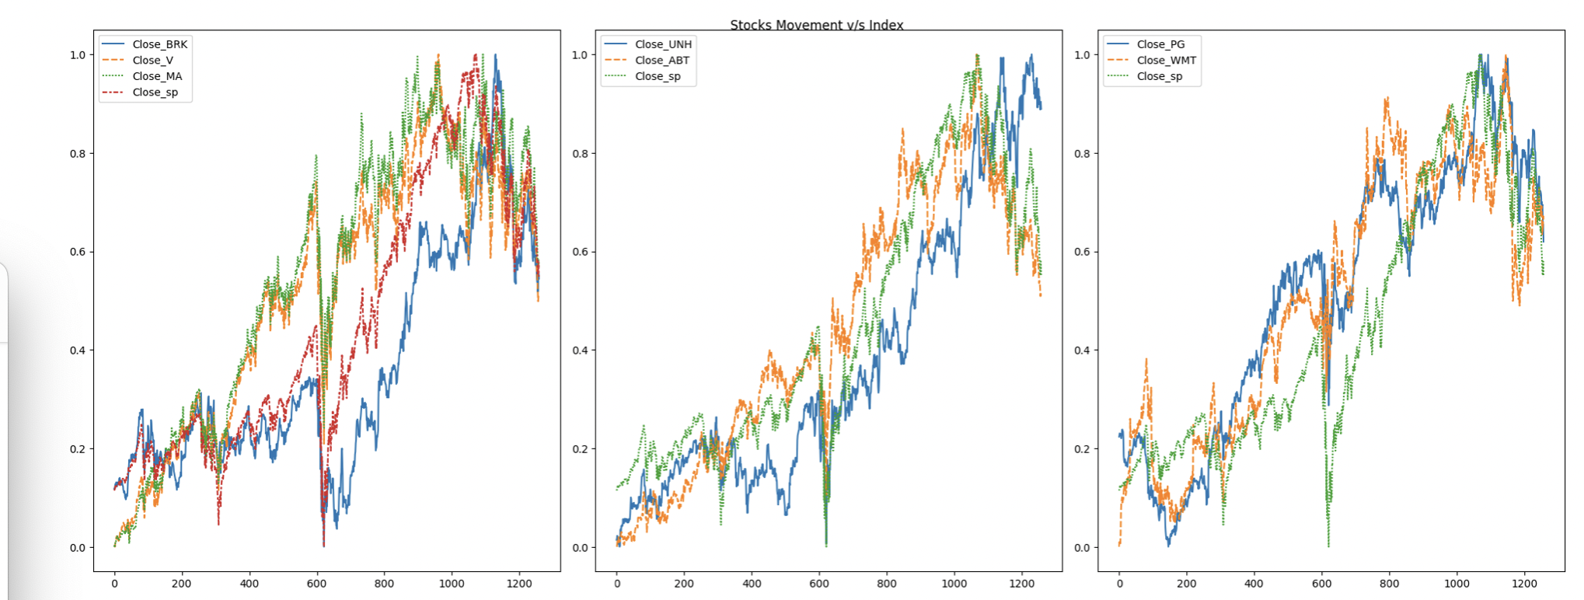
Normalization Of Closing Prices To Market Index
After correlation matrix , we have compared the two highly correlated stocks per category with the market index price variation over a line graph.
FINDINGS:
The stocks namely; V,MA ,ABT,WMT and PG have outperformed the market index over the period of time so these could be stocks that have high chances of more returns and less risk in coming times.

Slide 14
Data Analysis
Volatility Analysis

Slide 15
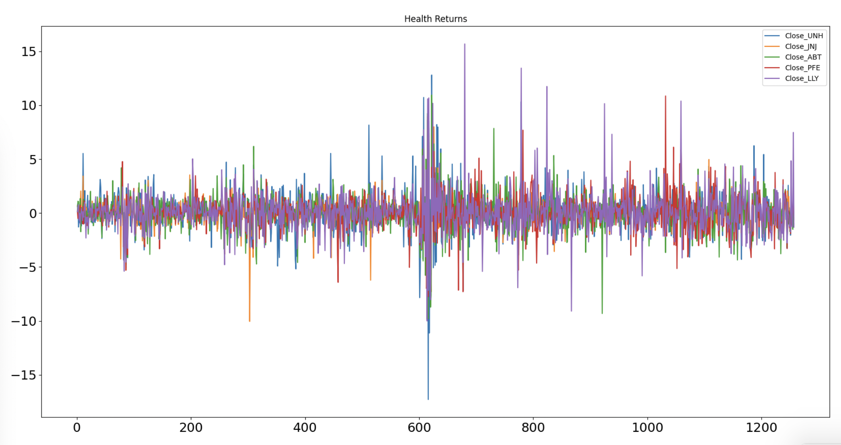
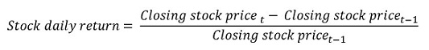
Daily Returns
Daily Returns per stock depicts the volatility in price change for a single day.
Herein the volatility is measured by number of peaks irrespective of high or low.
Findings:
For the plot of Health stocks daily returns data, LLY is the highest volatile stock while the JNJ is the least volatile stock.

Slide 16
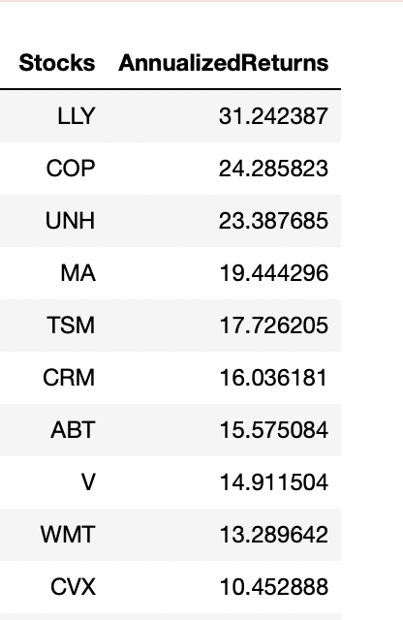
Annualized Returns
Annualized returns is the geometric average mean of money earned over a period of time, since the gain or loss for an investment in one year is dependent on the returns from previous year.
Stocks with annualized returns of more than 10% are generally considered good returns.
From table, the annualized returns are highest for the LLY with 31.24%, followed by COP and UNH with 24.28% and 23.38% respectively.

Slide 17
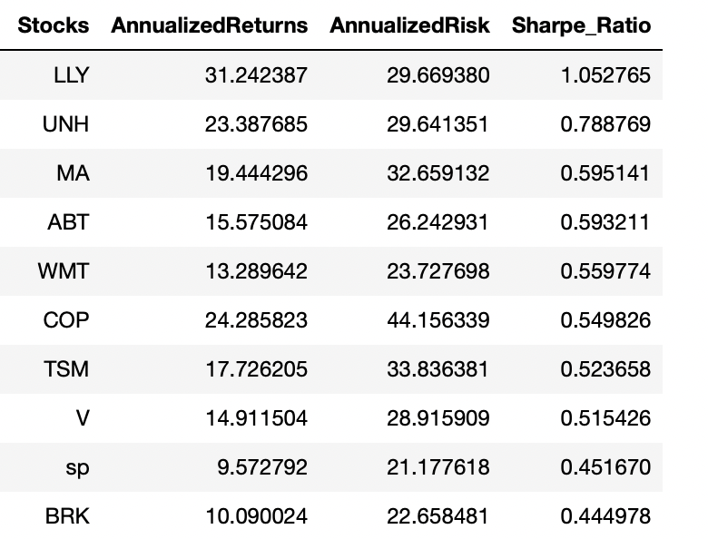
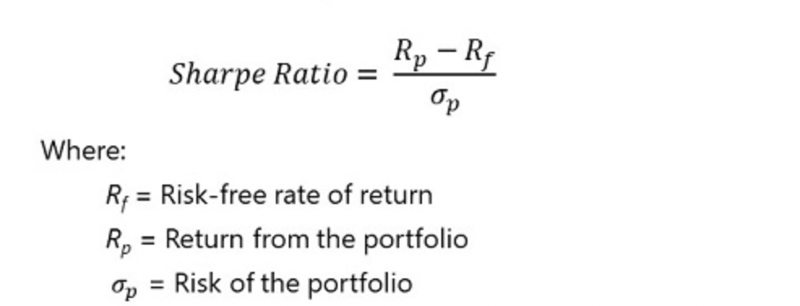
Annualized Risk and Sharpe Ratio
Risk is directly linked to the volatility in the stock prices.
The risk is simply calculated by taking the standard deviation of each stock and multiplying it with 252 trading days.
The basic understanding of the sharpe ratio is the ratio of excess returns to the ratio of the risk in the investment.
The stocks with sharpe ratio close to 1 are good choice since 1 is the ideal sharpe ratio but anything with a negative sharpe ratio should not be included in the portfolio.

Slide 19
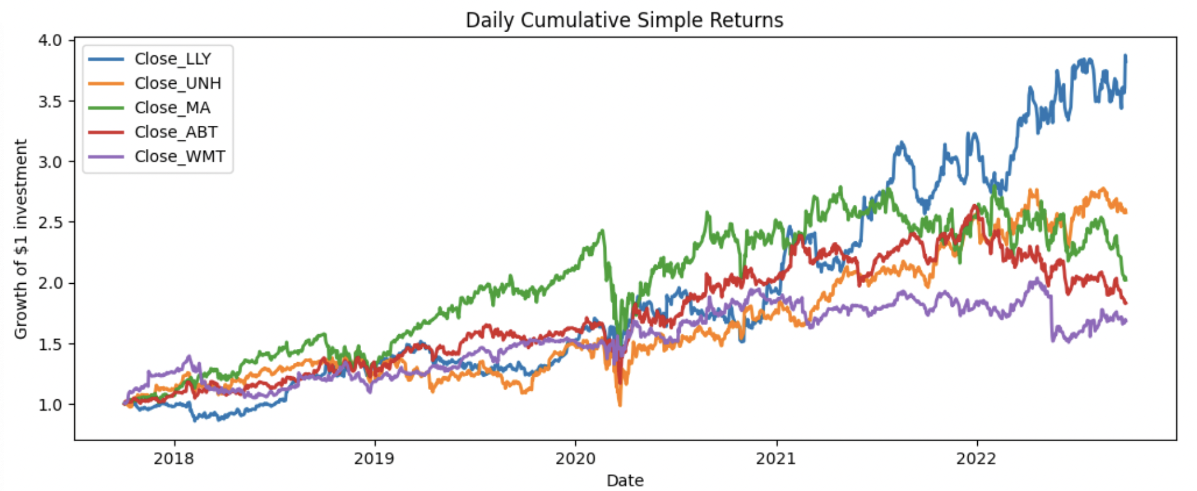
Portfolio Returns
As per the risk and return analysis of stocks, we have shortlisted stocks namely LLY,UNH,MA,ABT and WMT for creating portfolio.
Portfolio weightage has been created using: LLY(40%), UNH(10%), MA(30%), ABT(10%) and WMT(10%).
Findings:
Expected Daily portfolio returns:0.000934
Expected annualised portfolio simple return : 0.2354
Three stocks selected from the Portfolio are from Health category.

Slide 20
THANKYOU

